Slide 1
Whole stand models for even-aged stands

Slide 2
Whole stand models – state variables
In whole stand models the state variables are all defined at stand level:
  Dominant height (hdom)
  Number of trees per ha (N)
  Basal area (G)
  Volume (V) and merchantable volumes (Vdi or Vhi)
  Biomass (W) and biomass per tree component (Wr, Ww, Wb, Wbr, Wl)
hdom, N and G are almost always principal variables
volume may be a derived or principal variable
biomass and biomass tree componente are usually derived variables (or do not exist)

Slide 3
Whole stand models – control variables
The most important control variables are
  Site productivity (climate and soil), very often expressed as site index
  Stocking control, either initial stand density and thinnings
  Application of fertilizers
  Genetics
  Other silvicultural techniques (weeding, pruning, irrigation, etc)
Selection of quantitative measures of stand density is therefore an important step in forest models development and/or application
The simulation of thinnings is also importante but it is difficult to simulate diferente thinning types

Slide 4
Components of a thinning
Intensity of thinning (interval between thinnings)
Severity of thinning (amount of “stand” removed in one thinning)
Type of thinning (thinning from below, thinning from above, selective thinning, etc) – selection of trees to be thinned
Type of thinning/tree selection is by far the most important/difficult component of the model

Slide 5
Stocking and stand density
Although stocking and stand density are terms that are often applied interchangeably in forestry use, the two terms are not synonymous
  Stand density denotes a quantitative measurement of the stand
  Stocking:
    Stocking refers to the adequacy of a given stand density to meet some management objective (Bickford et al. 1957)
    Stands may be referred to as understocked, fully stocked, or overstocked
    A stand that is “overstocked” for one management objective could be “understocked” for another

Slide 6
Quantifying stand density
Stand density is a quantitative term describing the degree of stem crowding within a stocked area
It can be expressed in absolute or relative terms
  Absolute measures of density are determined directly from a given stand without reference to any other stand
  Relative density is based on a comparison with a selected standard density, usually the “fully stocked” stand or the open-grown trees (the extremes)

Slide 7
Quantifying stand density
Absolute measures of stand density
  Basal area
  Number of trees per ha
Relative measures of stand density
  Stand density index
  Crown competition factor
Other stand density measures
  Relative spacing
  Spacing factor
  Percent crown cover

Slide 8
Stand density index (SDI)
SDI evaluates stand density by comparing it with the maximum density for a stand with the same quadratic mean dbh (dg) – limiting situation or self-thinning line
For any given dg there is a limit to the number of trees per unit that can be carried
Reineke (1933) noted that for a variety of species the slope of the limiting line was approximately -1.6 on the log-log scale

Slide 9
Stand density index (SDI)
Maritime pine data - PORTUGAL

Slide 10
Stand density index (SDI)
Maritime pine data - PORTUGAL

Slide 11
Stand density index (SDI)
SDI is based on the evaluation of the difference between the number of trees in the stand and the maximum number of trees it could sustain according to the self-thinning line
SDI assumes that an understocked stand is located in a logN-logdg line parallel to the self-thinning line but with a smaller intercept

Slide 12
Stand density index (SDI)

Slide 13
Stand density index (SDI)
The intercept for a stand can be obtained as
The index is “normalized” by using the dg=25 as a basis for comparison

Slide 14
Stand density index (SDI)
The expression for SDI in a particular stand is then obtained:

Slide 15
Stand density index (SDI)

Slide 16
Crown competition factor (CCF)
CCF reflects the relationship between the area available for the average tree of the stand and the maximum area that the tree could use if it was growing in open space (open-grown tree)
The computation of CCF requires the study of the relationship between crown width of an open-grown tree (cw_{og}) and its dbh (d_{og}), usualy linear:

Slide 17
Crown competition factor (CCF)
The crown of an open grown tree ocupies the area ca_{og}:
CCF is then computed as the sum of the ca_{og} values for all the trees in the stand, expressed as a percentage of the plot area:

Slide 18
Relative spacing (Rs)
RS is a stand density measure that relates the mean distance between trees with the dominant height
It is based on the assumption that the stand density must decrease as the stand developes (the dominant height increases)

Slide 19
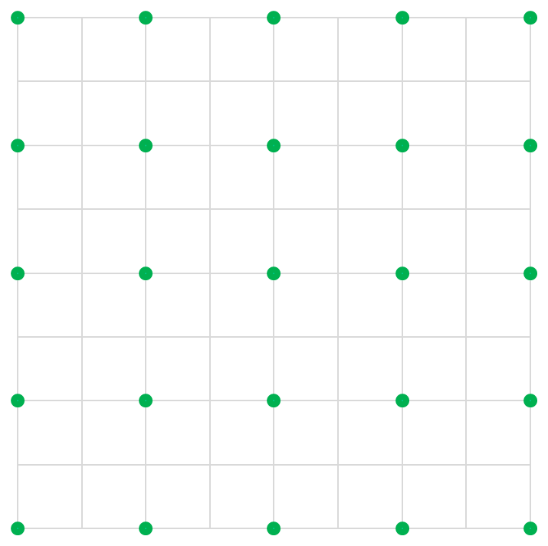
Relative spacing (Rs) - the Wilson factor (Fw)
Assuming that the trees are regularly spaced, the area available per tree is:

Slide 20
Relative spacing (Rs) - the Wilson factor (Fw)
Assuming that the trees are regularly spaced, the area available per tree is:
The relative spacing can be written in the form usuually known as wilson factor

Slide 21
Spacing factor (Sf)
Sf is a stand density measure that relates the average distance between trees to the crown width of the average tree:
If a regularly spaced stand is assumed, Sf comes as:

Slide 22
Crown cover(Cc)
Crown cover (Cc) is a stand density measure that computes the percentage of area covered with crowns :

Slide 23
Whole stand models for even-aged stands (WSM-eas)
Site productivity
  A system of site index curves is the most common way to express site productivity in WSM-eas
  In species in which age is difficult to determine:
    Site index may be assessed with a site prediction equation
    Site productivity may be included in the several sub-models through climatic and soil variables

Slide 24
Whole stand models for even-aged stands (WSM-eas)
Notation
    S = site index or site variables (climate and soil)
    t_{i} = stand age at time t_{i}
    X_{i} = principal stand variable X at time t_{i}
    SD_{i} = stand density measure at time t_{i}
    i_{X1-2} = growth of variable X in the period between t₁ and t₂
    Y_{i} = derived stand variable Y at time t_{i}

Slide 25
Whole stand models for even-aged stands (WSM-eas)
Growth modules
  Growth modules refer to principal variables, the ones whose growth is predicted by the model:
    Direct prediction of growth
      i_{X1-2} = f(S, t₁, t₂, SD₁)
      X₂ = X₁+i_{X1-2}
    Direct prediction of future value – difference equations
      SD2 = f(S, t₁, t₂, SD₁, other stand variables)
      X₂ = f(S, t₁, t₂, X₁, SD₁, SD_{2,} other stand variables)

Slide 26
Whole stand models for even-aged stands (WSM-eas)
Calculus module
  Calculus modules refer to derived variables, the ones that are computed from other variables at the same point in time:
      Computed variable:
      Y₂ = f(S, t₂, SD_{2,} other stand variables)

Slide 27
Whole stand models for even-aged stands (WSM-eas)
Stand response to silvicultural treatments
  Including stand response to silvicultural treatments into the forest models is crucial for the selection of the most efficient management
  In spite of this importance, there is no established theory and the study of such models is usually made through examples
  Some examples from Burkhart and Tomé (2012) are presented here as an illustration

Slide 28
Whole stand models for even-aged stands (WSM-eas)
Stand response to thinning
  Pienaar and Shiver (1986)
    t_{t} = plantation age at last thinning
    N = present number of trees per unit area
    N_{t} = number of trees removed in last thinning
    N_{at} = number of trees remaining after last thinning
    G = basal area per unit area
    t = plantation age
    hdom = dominant height

Slide 29
Whole stand models for even-aged stands (WSM-eas)
Stand response to thinning
  Pienaar and Shiver (1986)
    The term (N_{t}t_{t}/N_{at}t) modifies the basal area of unthinned plantations of a given age, stems per unit area, and average dominant height to predict the basal area for comparable thinned plantations
    In the non-logarithmic form of the prediction equation, it is a multiplicative modifier theoretically between 0 and 1
    For any given age, t, the earlier a thinning of given intensity (N_{t}/N_{at}) occurs, the larger (closer to 1) the modifier will be
    If thinnings of different intensities occur the same time ago, so that (t_{t}/t) and N_{at} are the same, then the modifier will be larger for the less intensive thinning.

Slide 30
Whole stand models for even-aged stands (WSM-eas)
Stand response to thinning
  Pienaar and Shiver (1986)
    A basal area projection equation was derived from the prediction equation

Slide 31
Whole stand models for even-aged stands (WSM-eas)
Now it is time to study the GLOBULUS model!

Slide 32
The end!!

